Slide 1
Making things spin
https://github.com/choltfo/HtN2019_Workshop
A crash course

Slide 2
Robotics & Automation
https://github.com/choltfo/HtN2019_Workshop
We are here!
Sensors
Processors
Actuators
Things you can control
The World
Things you cannot control

Slide 3

About me
https://github.com/choltfo/HtN2019_Workshop
Waterloo Mechatronics Engineering, 3rd year
From Ottawa, ON
Long time hacker/maker
Builder of things for ~10 years
Former Hacksmith Industries co-op
https://choltfo.github.io/

Slide 4
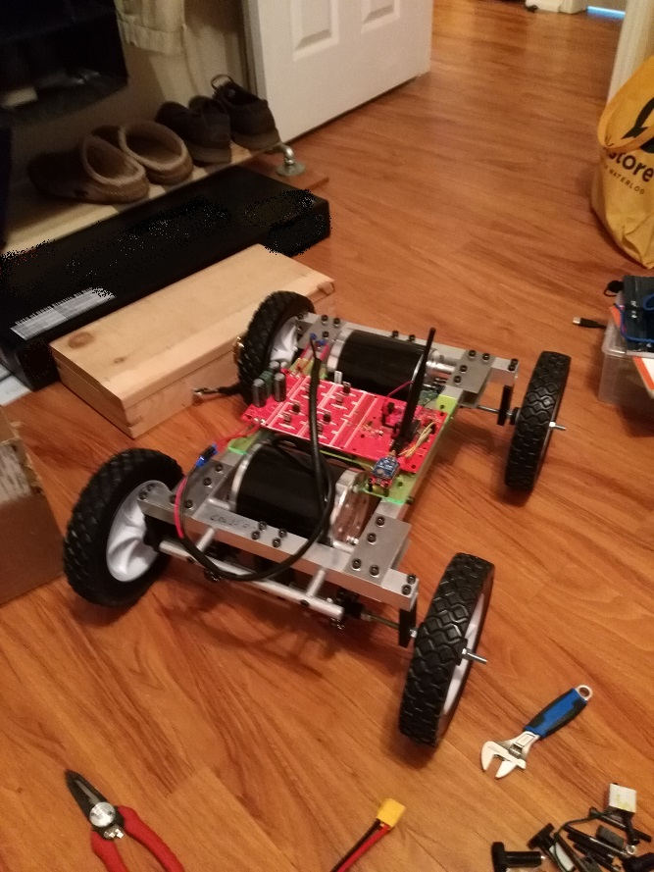
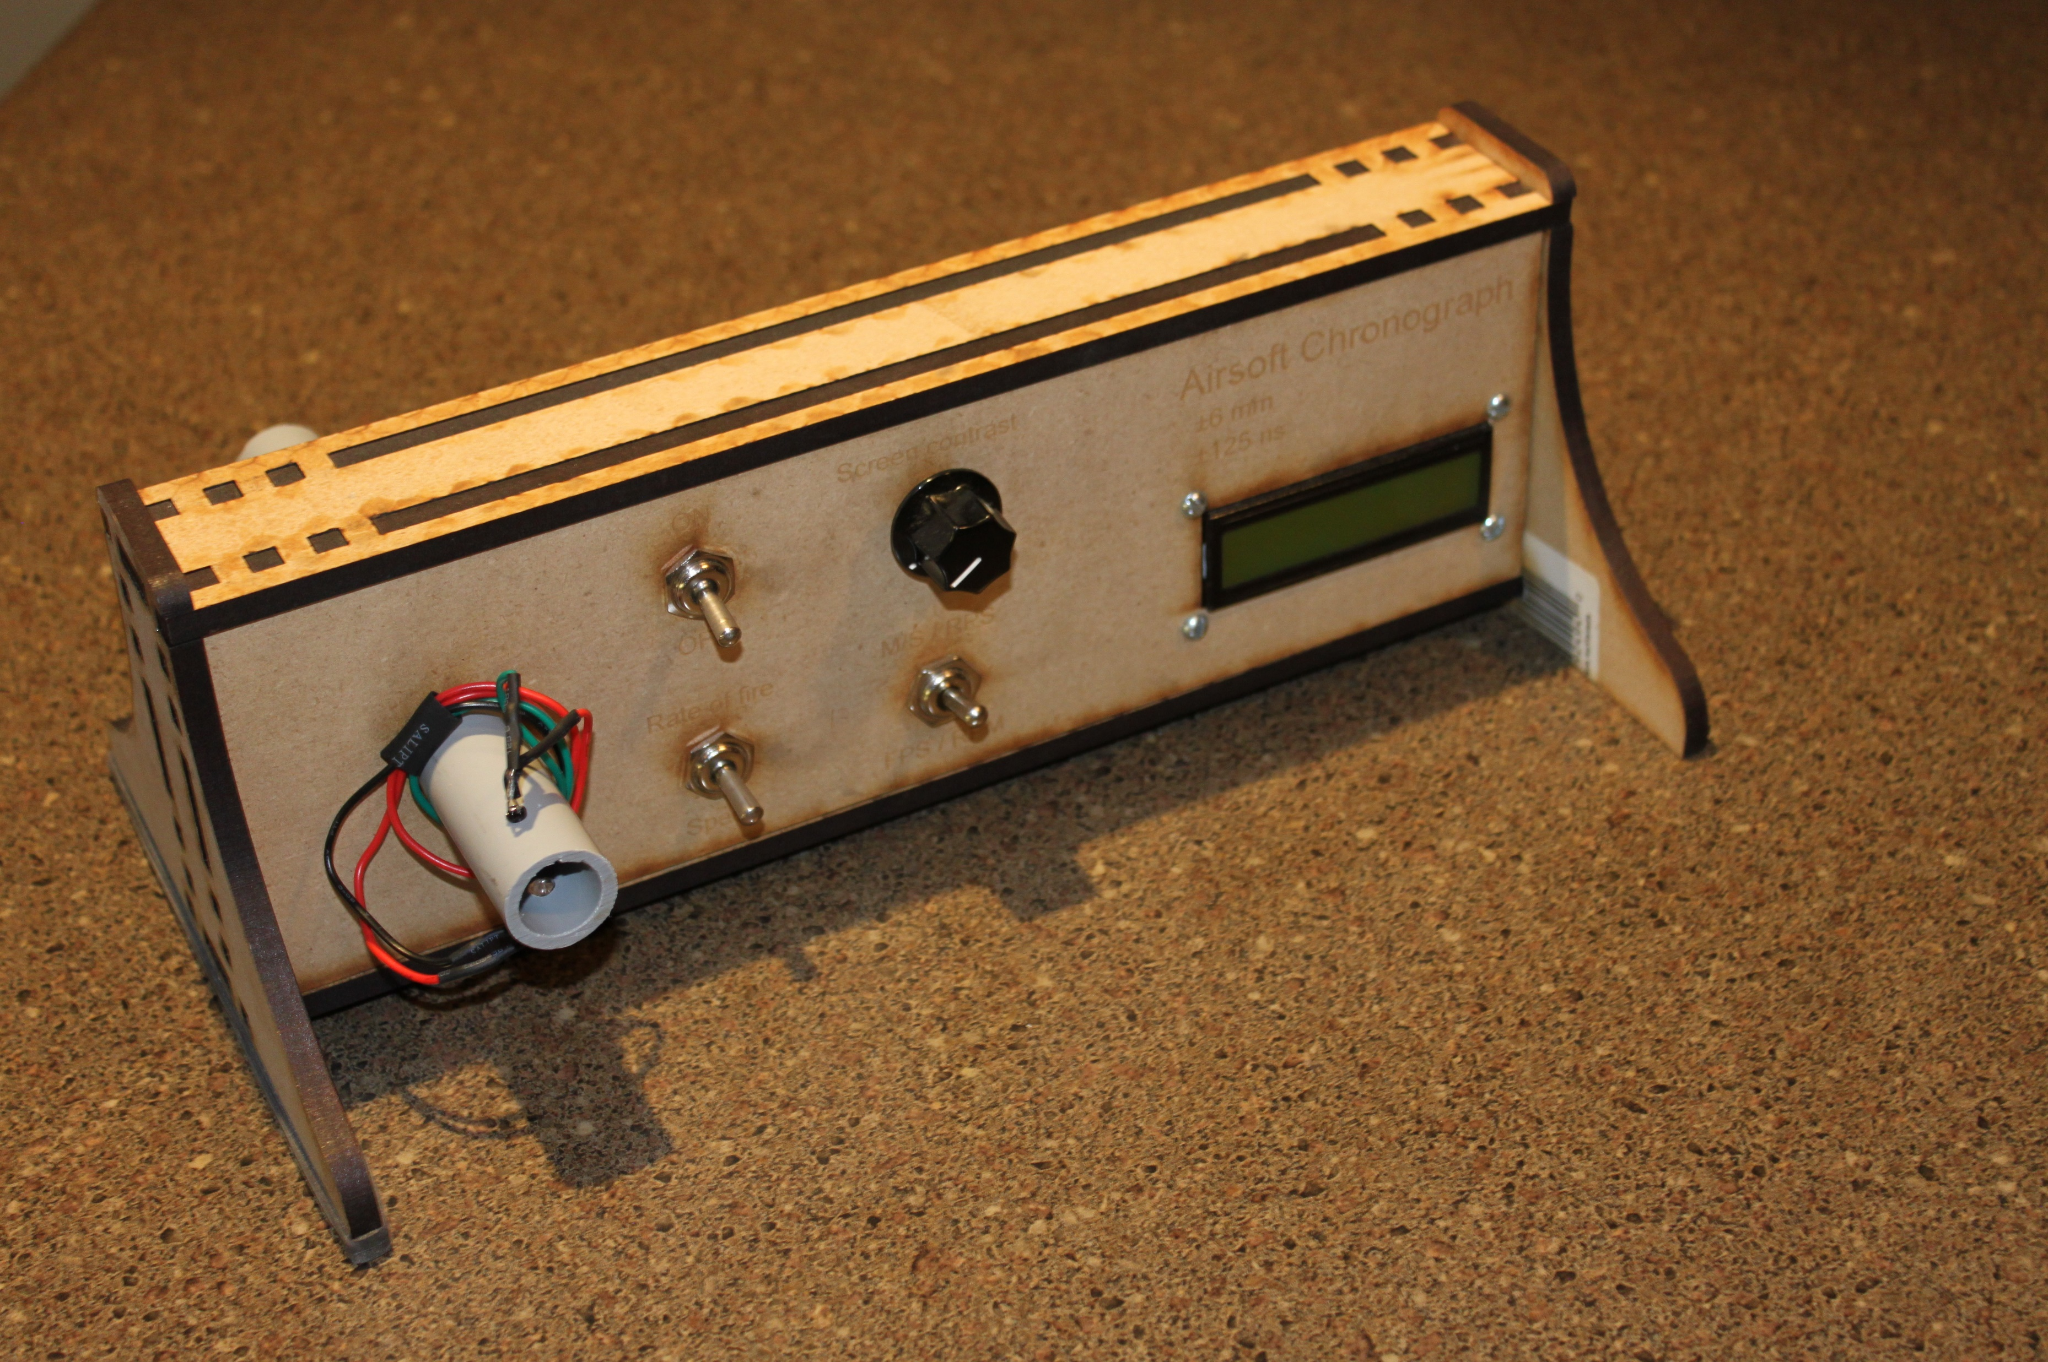
About me
https://github.com/choltfo/HtN2019_Workshop

Slide 5
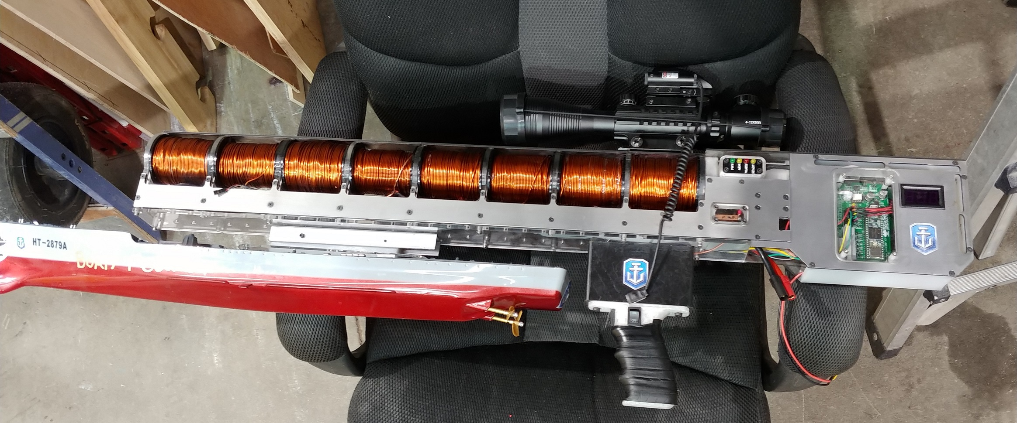
About me
https://github.com/choltfo/HtN2019_Workshop

Slide 6
About me
https://github.com/choltfo/HtN2019_Workshop
Working on:
Bigger coil gun
Pneumatic biomimetic articulator
Tesla coil
Feel free to ask me about stuff after the workshop or during the break!
Notes:
The one constant with all of these projects is that they involves the same problems as motor control. So let’s dive into that.

Slide 7
What we’re going to be covering
https://github.com/choltfo/HtN2019_Workshop
Brushed DC motors
Brushless DC motors (BLDC)
Steppers
Servos
And how to run all of them
In theory
In practice

Slide 8
A quick note on practicality…
https://github.com/choltfo/HtN2019_Workshop
With a few exceptions…
DIY motor drivers:
Great learning experience!
Someone already did it better
Someone already did it cheaper
DIY motors:
Great learning experience!
Someone already did it better
Someone already did it cheaper

Slide 9
Glossary 1/2
https://github.com/choltfo/HtN2019_Workshop
Two mechanical parts:
Rotor
Rotates (The spinny bit)
Usually internal (But not always)
Stator
Stays (The frame)
Usually external (But not always)

Slide 10
Glossary 2/2
https://github.com/choltfo/HtN2019_Workshop
Inductive kick:
The tendency of inductors to create huge voltage spikes
See Afrotechmds: https://www.youtube.com/watch?v=LXGtE3X2k7Y
Also called “flyback voltage”
MOSFET:
Metal-oxide-semiconductor-field-effect-transistor
(Magically Obliterated Smoke and Fire Emitting Transistor)
Technically: Voltage controlled resistor
Practically: Voltage controlled switch
Notes:
ANY QUESTIONS

Slide 11
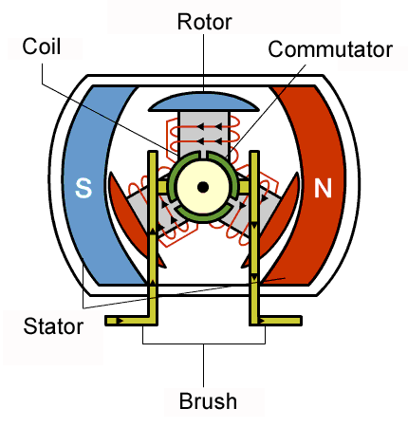
Brushed DC Motors
https://github.com/choltfo/HtN2019_Workshop
Mechanically switched electromagnet on the rotor
Permanent magnet on the stator
Speed: Fast
Price: Low
Weight: High
Power: Phone buzzers to power tools
Ease of use: High

Slide 12
Brushed DC Motors
https://github.com/choltfo/HtN2019_Workshop
Speed = K E
Torque = K I
V = R I + E

Slide 13
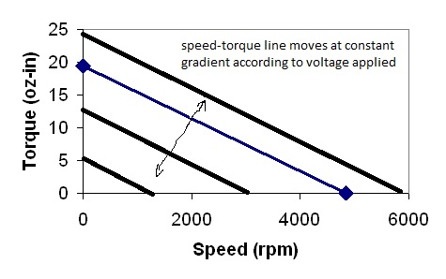
Brushed DC Motors (Picking a Motor)
https://github.com/choltfo/HtN2019_Workshop
Operating voltage
Maximum speed = K*voltage
Torque/speed curve
Available with every motor...
If you look hard enough
Max torque at stall (0 speed)
0 torque at max speed
Maximum current
How much current does your motor use when stalled?
Determines your driver’s specs.

Slide 14
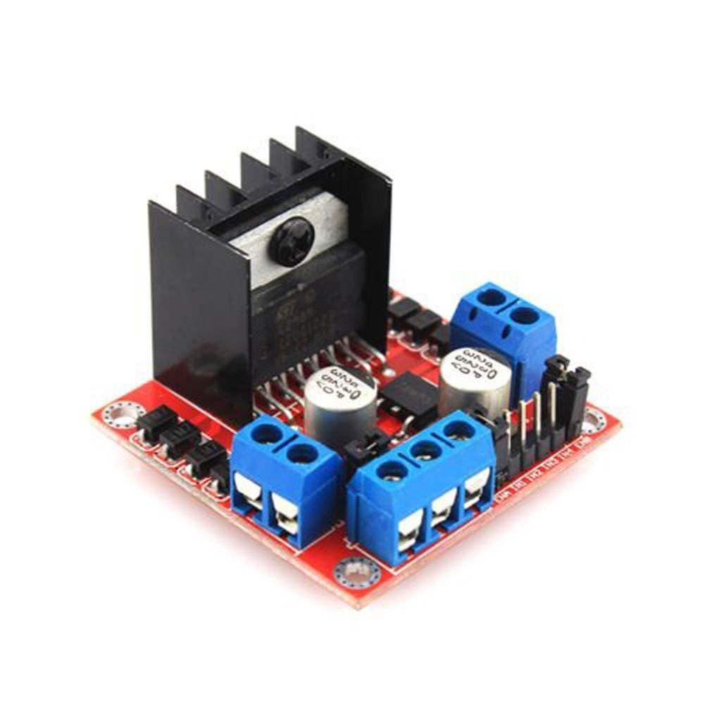
Brushed DC Motors (In practice!)
https://github.com/choltfo/HtN2019_Workshop
Forward and reverse:
Buy an H-bridge motor driver
Just forward:
MOSFET and flyback diode
Use PWM (analogWrite on Arduino)

Slide 15
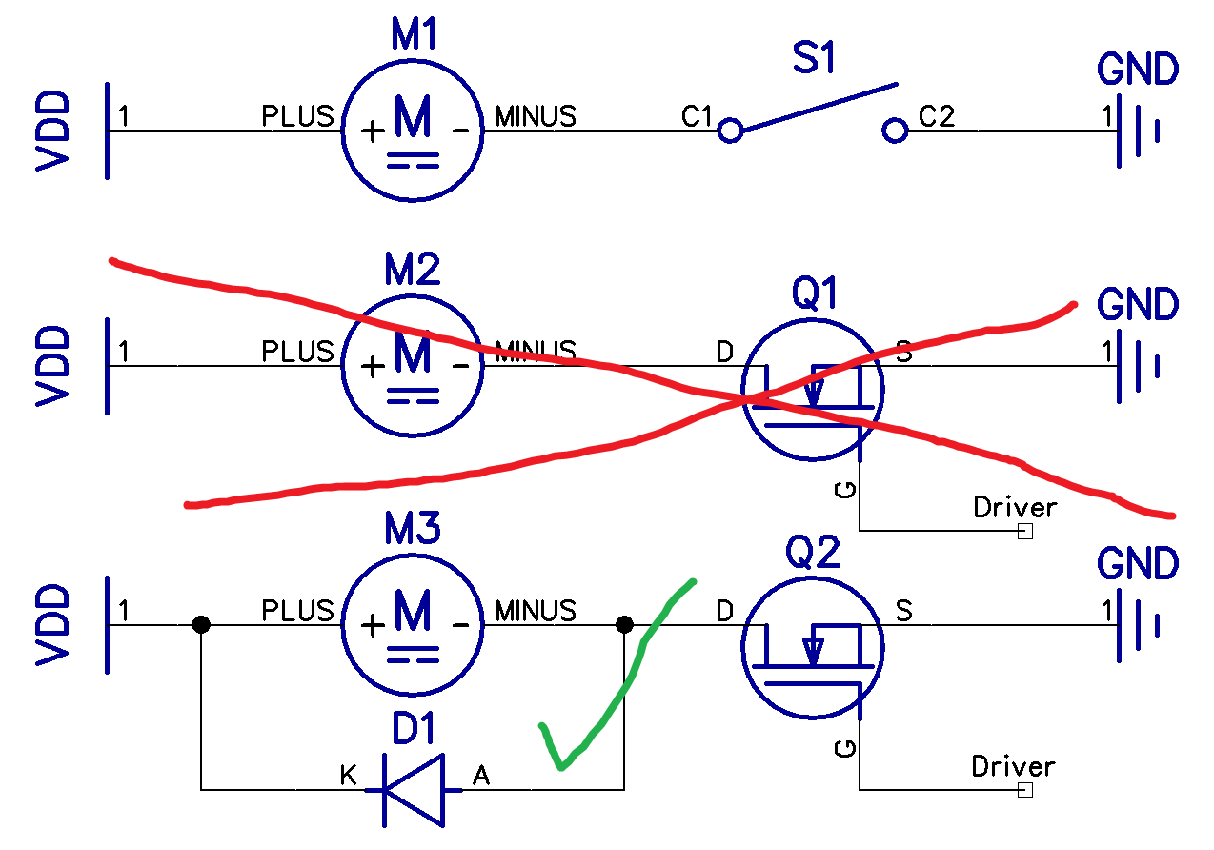
Brushed DC Motors (In theory!)
https://github.com/choltfo/HtN2019_Workshop
Making it spin in one direction:
Give it juice.
No, seriously. It’s that easy.
To speed control, use PWM!
Turn it on and off really fast.
Flyback diodes or death!

Slide 16
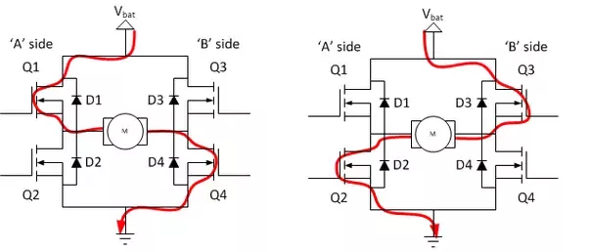
Brushed DC Motors (In theory!)
https://github.com/choltfo/HtN2019_Workshop
H bridge
Forward/backwards
Braking
Coasting
Speed control
More complicated
Use an H-bridge driver chip
Either with the MOSFETs in it, or
With connections to the gates of big MOSFETs
Notes:
ANY QUESTIONS

Slide 17
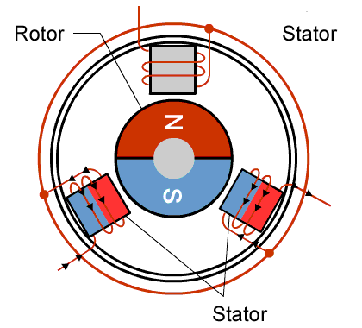
Brushless DC Motors
https://github.com/choltfo/HtN2019_Workshop
3-phase electrically switched electromagnets on stator
Permanent-magnet rotor
Speed: Very fast (>25,000 RPM)
Price: Medium
Weight: Low
Power: Tiny quadcopters to electric cars
Ease of use: Moderate to difficult

Slide 18
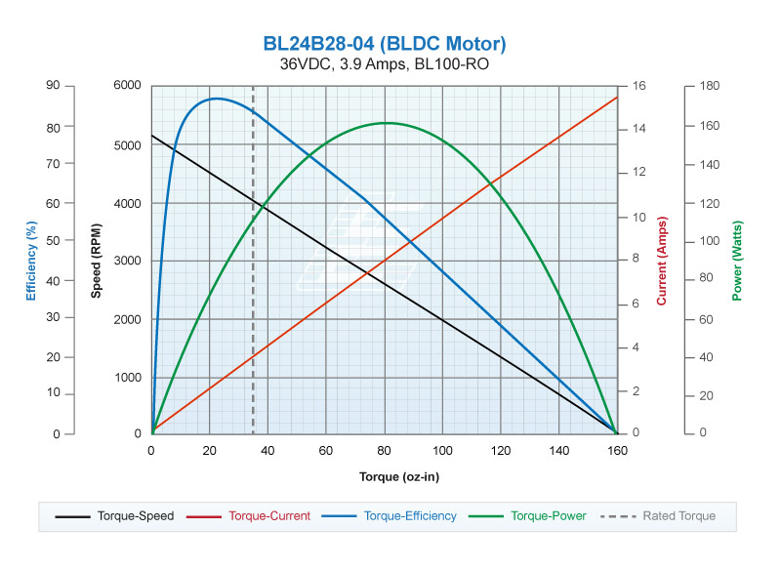
Brushless DC Motors (Picking a Motor)
https://github.com/choltfo/HtN2019_Workshop
Operating voltage
Maximum speed = K*voltage
K = “Kv” rating (~1500 RPM/V)
Torque/speed curve
A bit more complicated, but…
Max torque at stall
No torque at max speed
Maximum current
Determines the driver you need
When in doubt, multiply by 1.5

Slide 19
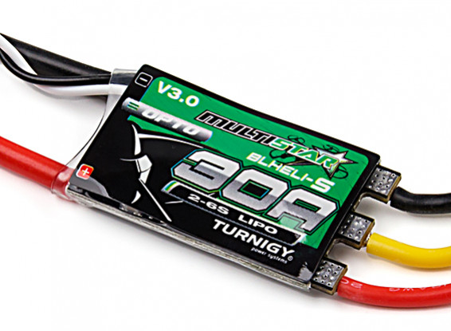
Brushless DC Motors (In Practice!)
https://github.com/choltfo/HtN2019_Workshop
Buy an ESC (Electronic Speed Controller)
Takes standard servo-motor PWM
Might double as a 5V supply
Battery on one side, motor on the other
1A to >300A
3V to >100V
Usually takes some tweaking
Read the manual!

Slide 20
Brushless DC Motors (In Practice!)
https://github.com/choltfo/HtN2019_Workshop
Actually a 3-phase synchronous AC motor
DC needs to be turned into AC
Use three “half-bridges”
Creates a rotating magnetic field around the rotor
Progression of the field pulls along the rotor.

Slide 21
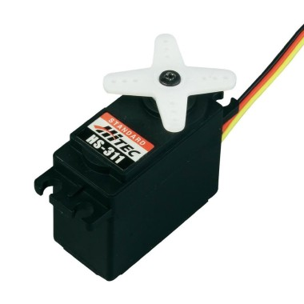
Hobby Servo Motors
https://github.com/choltfo/HtN2019_Workshop
Provides a constant speed or position
Has its own tiny computer in it
Speed: Slow
Price: Varies
Weight: Varies
Power: Varies
Ease of use: High

Slide 22
Hobby Servo Motors (In Practice!)
https://github.com/choltfo/HtN2019_Workshop
Connect the brown and red wires to GND and 5V
BROWN to GND
RED to 5V
Connect the yellow wire to a control pin
Digital I/O pin on Arduino
Use a servo library (Servo.h on Arduino)

Slide 23
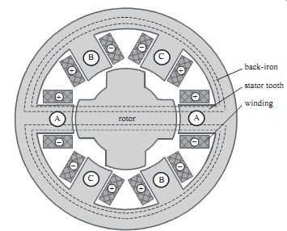
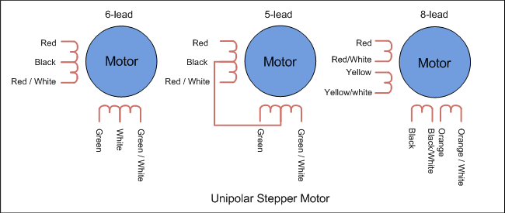
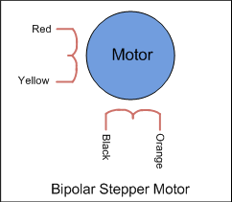
Stepper Motors
https://github.com/choltfo/HtN2019_Workshop
Progress one increment/step at a time
Needs a stepper driver
Comes in bipolar and unipolar flavours
Four wires

Slide 24
In practice
https://github.com/choltfo/HtN2019_Workshop
Two kinds of driver:
Cheap ones:
Provides a connection to either ground or V+ for each pin according to the pins you have connected
4-pin inputs
Control is your problem!
Good ones:
Handles all of the weirdness internally
Microswitching
Step/direction inputs

Slide 25
Trying it live!
https://github.com/choltfo/HtN2019_Workshop
Brushed motor
Arduino
MOSFET
Diode
Motor
Stepper
Stepper driver
Arduino
Stepper motor
Read the comments in the examples
Servo:
Arduino
Wires (3)
Servo motor

Slide 26
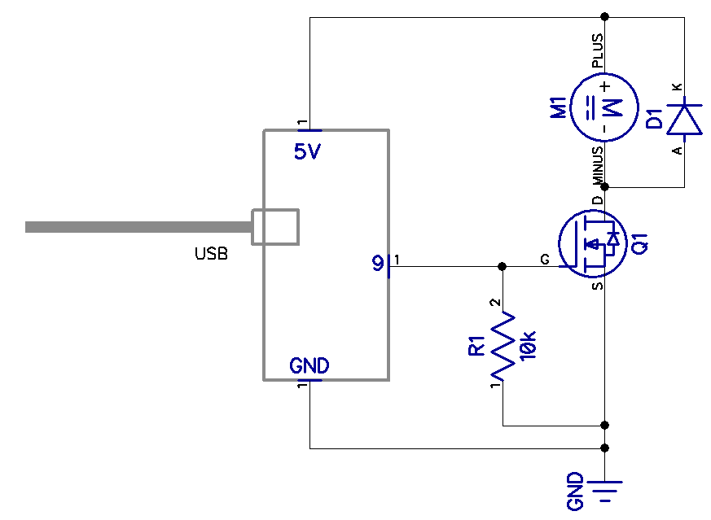
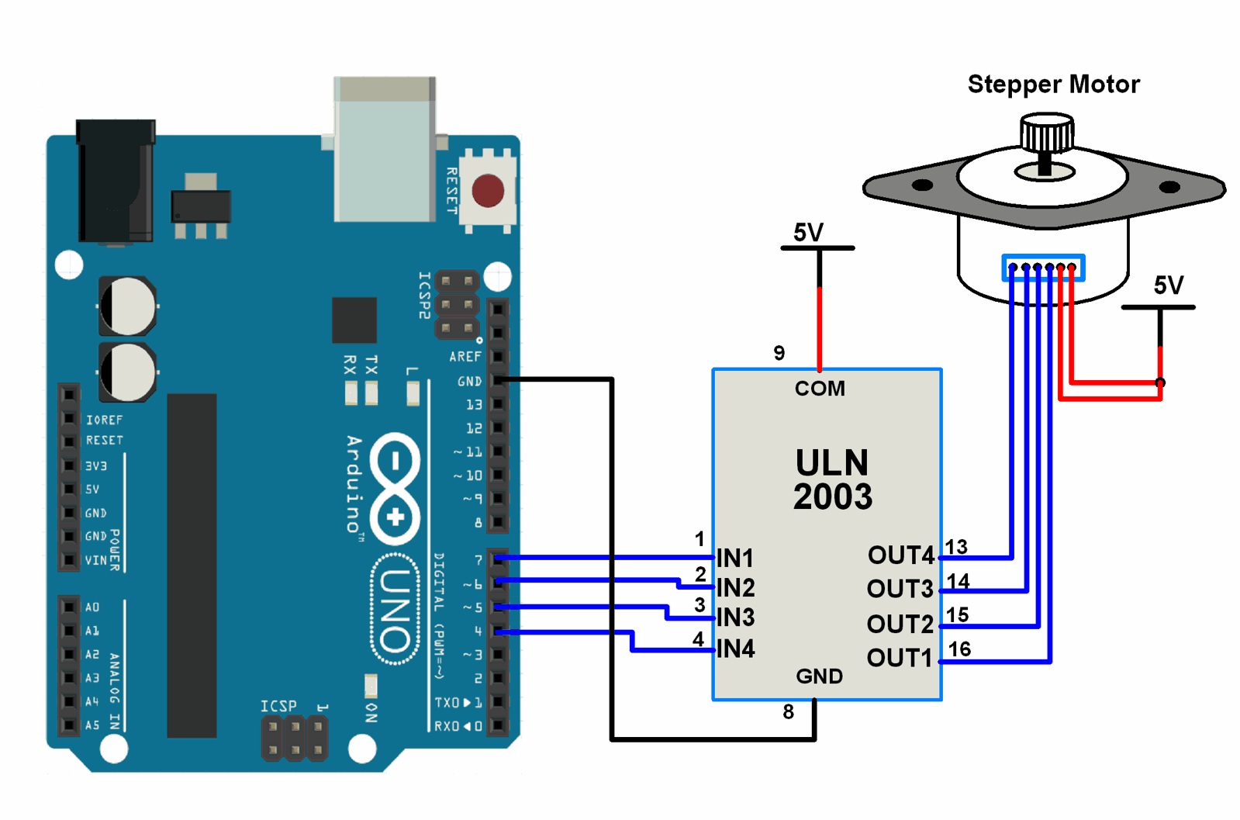
Schematics
https://github.com/choltfo/HtN2019_Workshop
Unipolar stepper motor
Brushed DC motor

